Slide 1
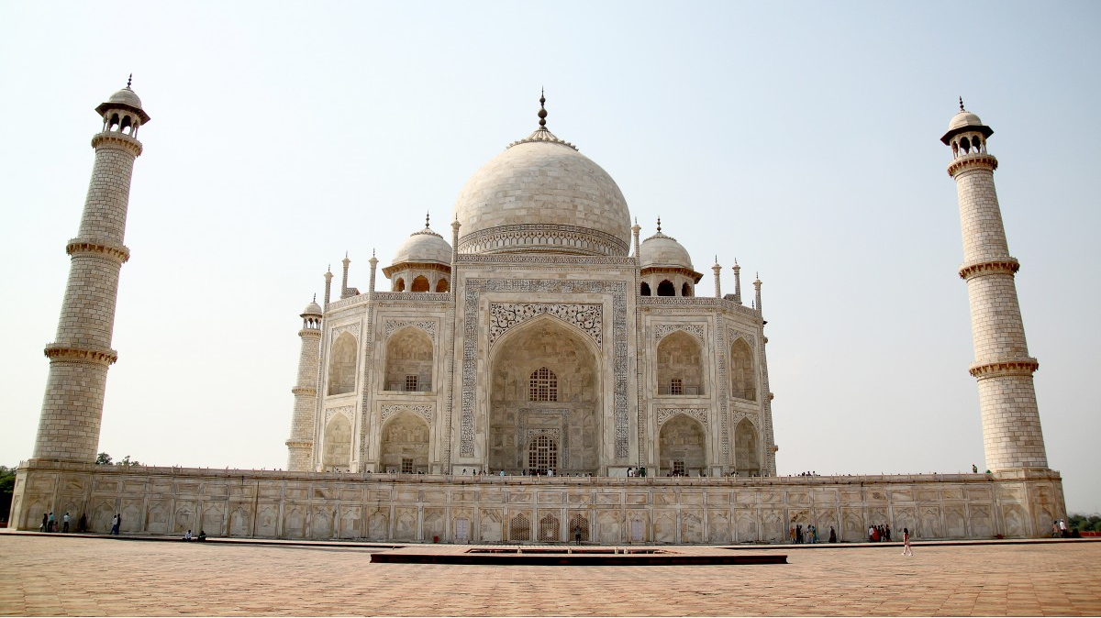
THE ART AND architecture OF INDIA
.

Slide 2
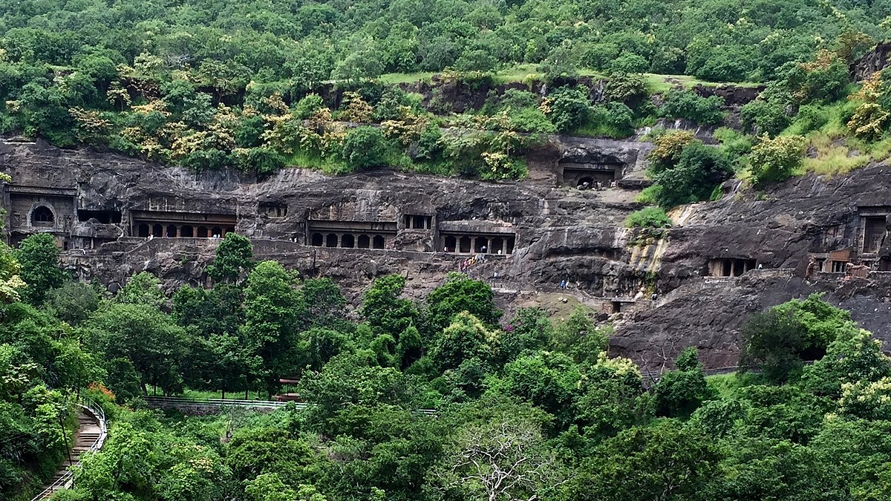
THE BUDDHIST CAVES :-
The Buddhist caves in India are an important form of rock cut architecture there are several features in these caves that make them very unique. There are several paintings and carving on the walls that make them different from other caves these caves were also the residential quarters for the Monks. These caves had stupas in them the caves of Karle and Kanheri have a lion pillar at their entrance. The cave of Bhaja is also had a wooden celling.

Slide 3
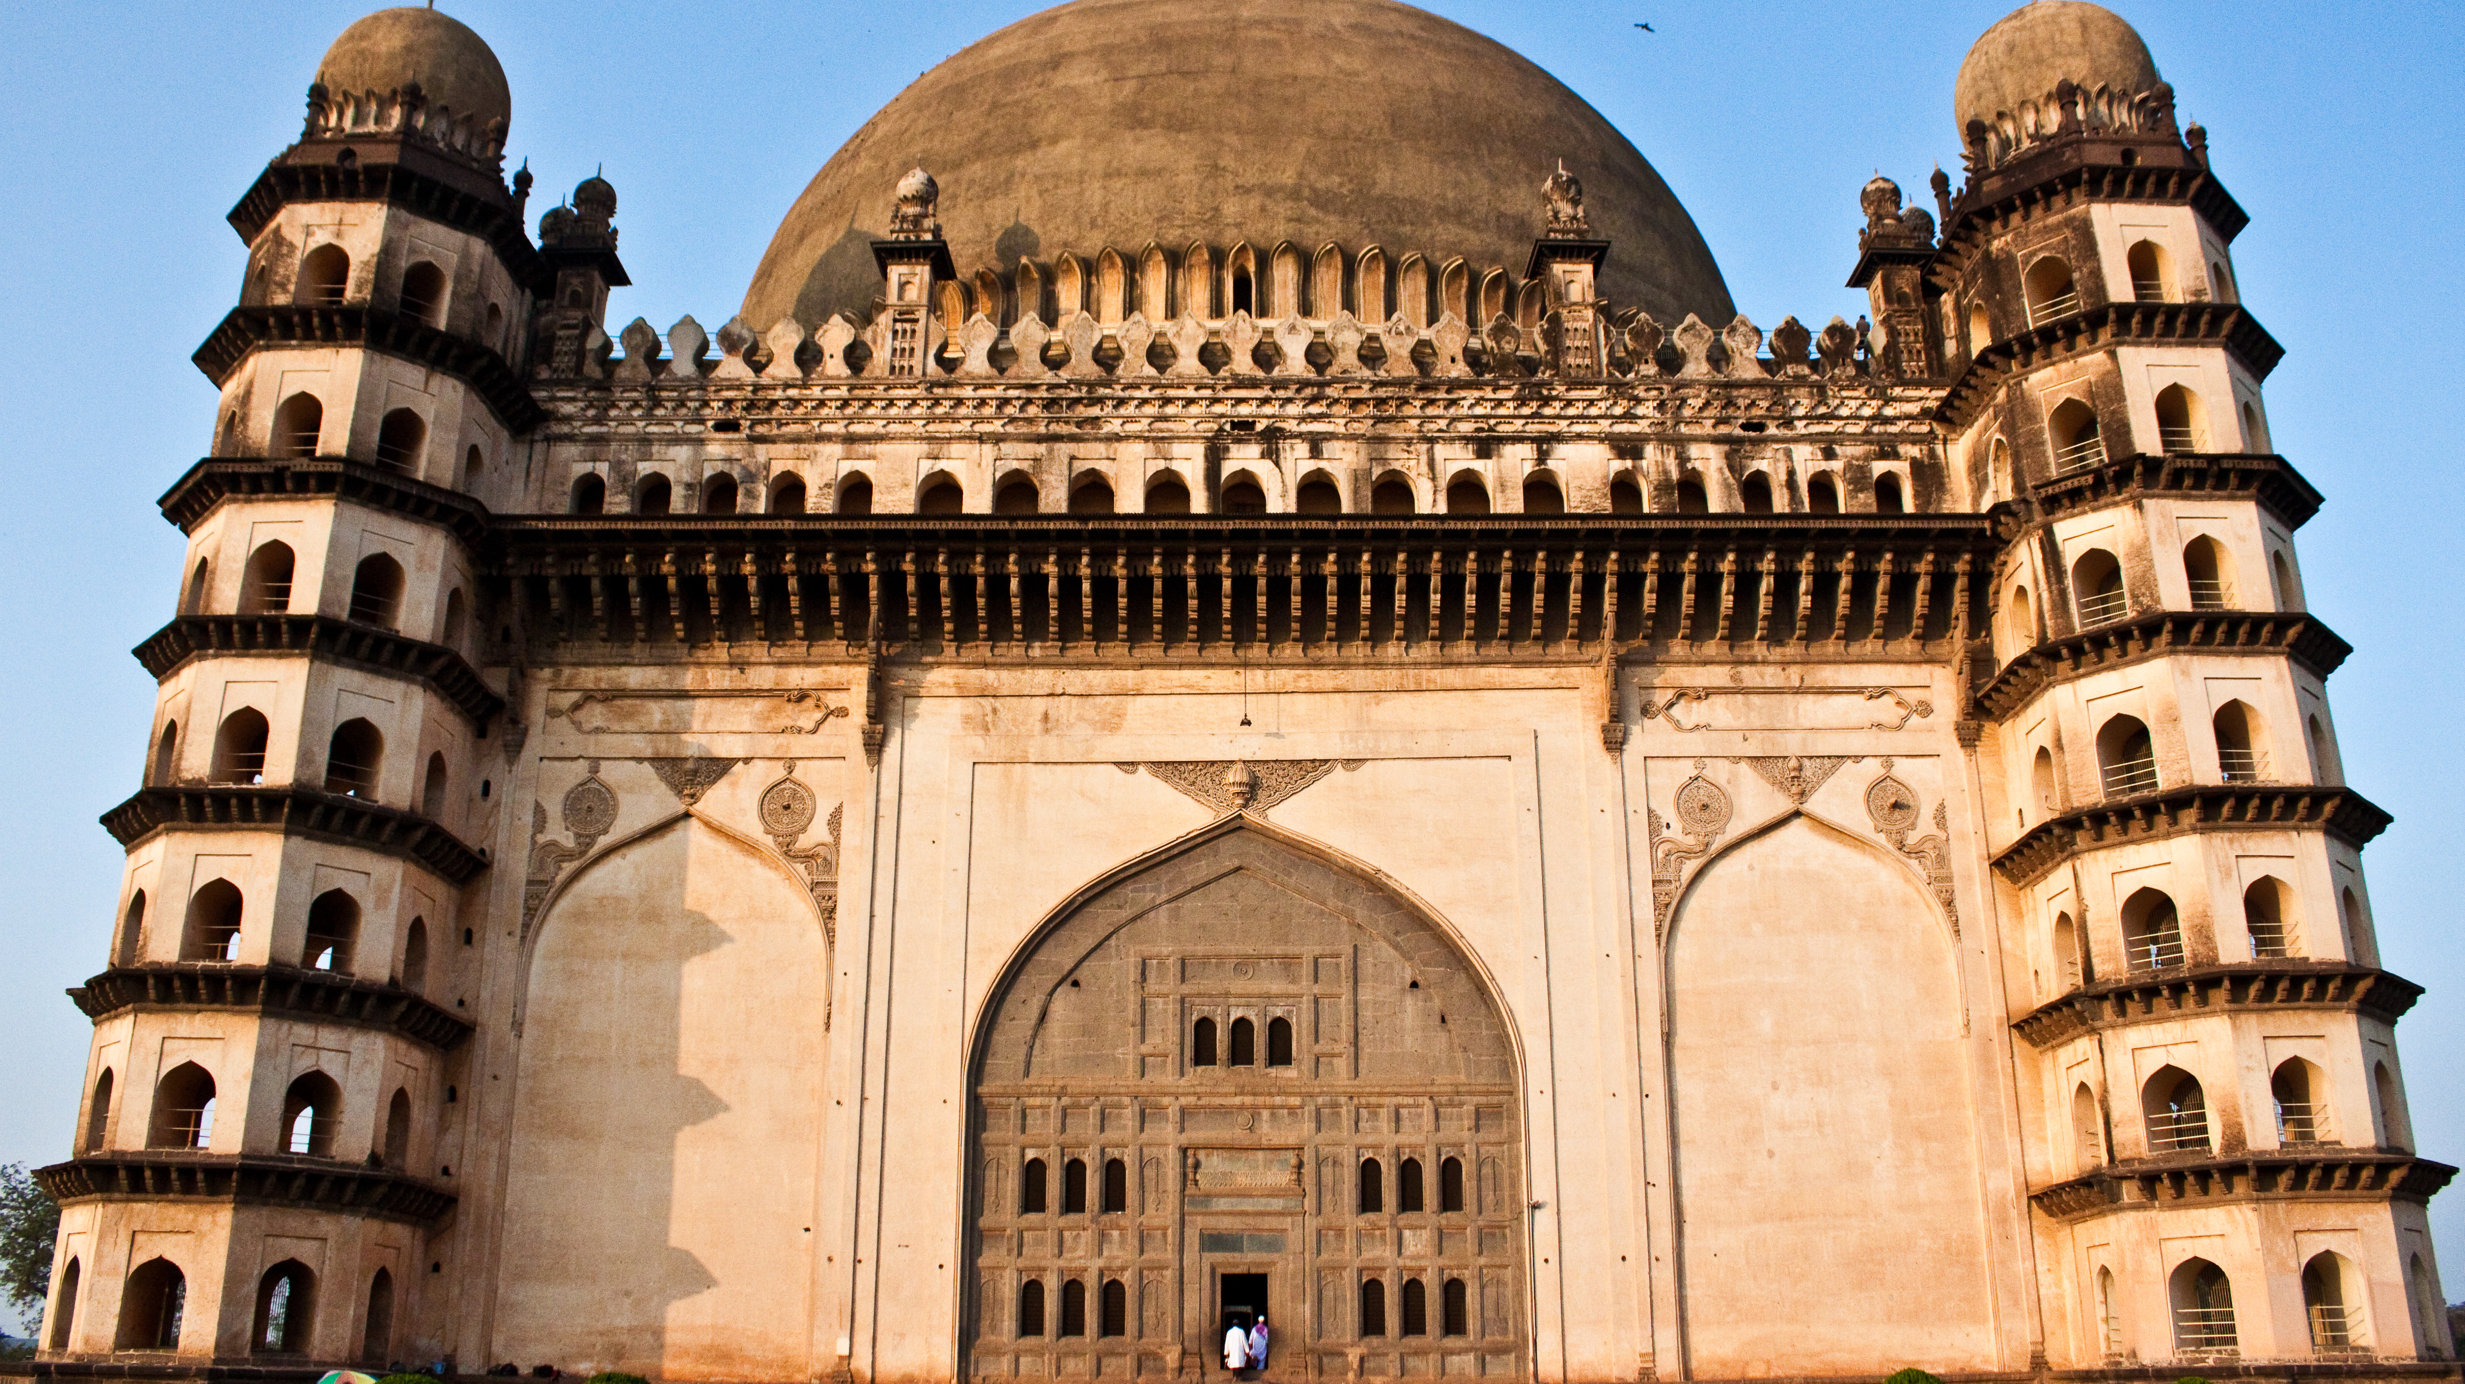
THE GOL GUMBAZ :-
The Gol Gumbaz of Bijapur is the mausoleum of King Mohammed Adil Shah. It is one of the largest single chambers ever built. The structure exhibits the Indo-Islamic style of architecture. The dome of the Gol Gumbaz is one of the largest domes ever built in the history. With a diameter of 144 feet. The dome structure is supported by eight intersecting arches. The Gol Gumbaz was built by the Yaqut of Dabul in the year 1626-1648.

Slide 4
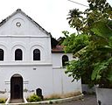
THE Mattanchetty Synagogue :-
The Mattanchetty Synagogue of Cochin is the most historical relevant locations at Kochi fort. It was built by Yehudan community in 1568 on a piece of land gifted to them by the King of Kochi. It is also called the "Pardesi Synagogue" or Synagogue. From outside it is an old clock tower which keeps ticking even now. Thousands of tourist visit it every year. People flock to Jew Street to catch a glimpse of this architecture and the lineage of the Jews who still follow the old customs.

Slide 5
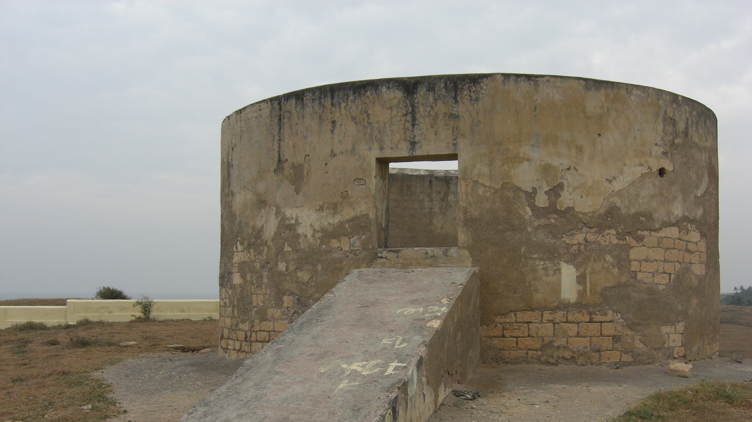
THE TOWER OF SILENCE
The Tower of Silence is a Zoroastrian funerary tower where excarnation rituals are carried out is threatened by the area's dwindling vulture population. In 2015, A decrease in vulture population of Mumbai caused great consternation of naturalists and the local Zoroastrian. The small but affluent community looks to these birds of prey for a peaceful passage after death, through the Tower of Silence, on Malabar Hill. The 300-year-old dakhma or funerary tower, located deep within a 54-acre forest, is where the bodies of deceased Zoroastrians are placed and exposed to scavenger birds, which as per their beliefs, is the most sacred way of dealing with the dead.

Slide 6
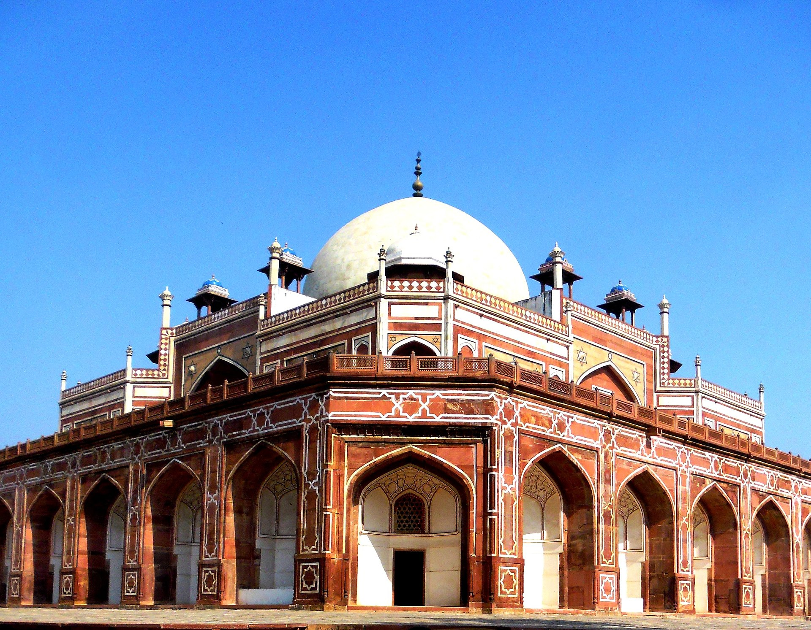
MADE BY:- atharav SHARMA
This P hoto by hhhUnknown author is licensed under CC BY-SA.

